Slide 1
Realty
Aldabergenova Dana
Bolatbek Gaukhar
Kadylov Nurber

Slide 2
Our team called onaonaopyat’. And this semester we did a project called onaonaopyat

Slide 3
The main idea of our project
The idea came from the fact that many Kazakh sites with sales and rentals were not very convenient,especially with the situation in the world, it was difficult to choose apartments and houses.

Slide 4
About project
PHP 7
HTML, CSS, JS
SQLite

Slide 5
The data tables that we used
Our database contains 6 tables:
home, history, city, bigdate, type, users

Slide 6
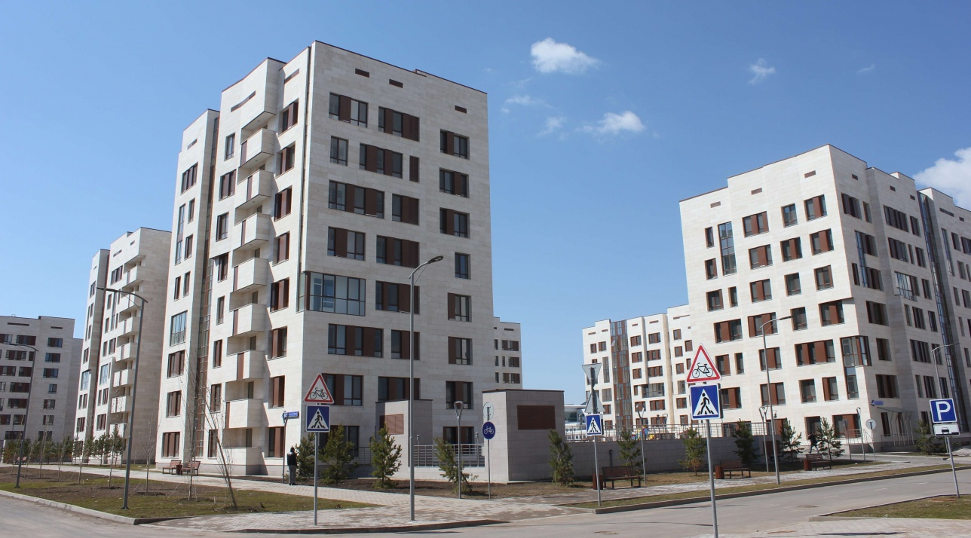

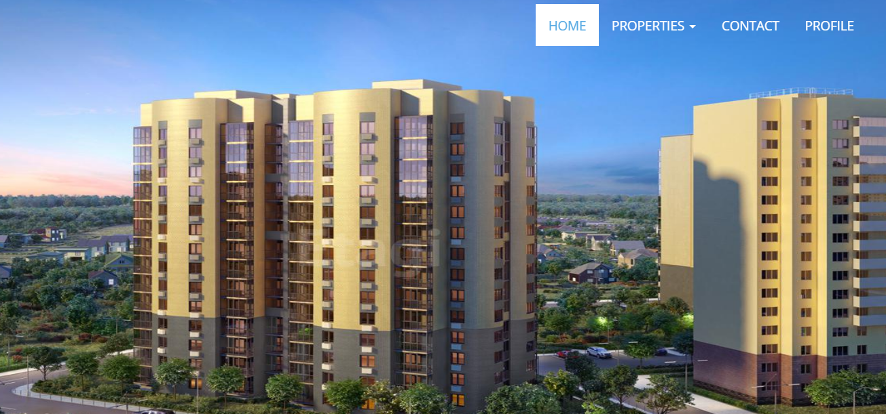
Interface and functionality
To implement the project, we will create a website where everyone can find a suitable apartment, or sell their own. A prerequisite for submitting an ad is a good video quality. For the beginning of the project we got in touch with the realtors from Astana, Almaty and Kyzylorda. They provided us with videos of apartments that are in the status of sale, as well as information about the apartments.

Slide 7
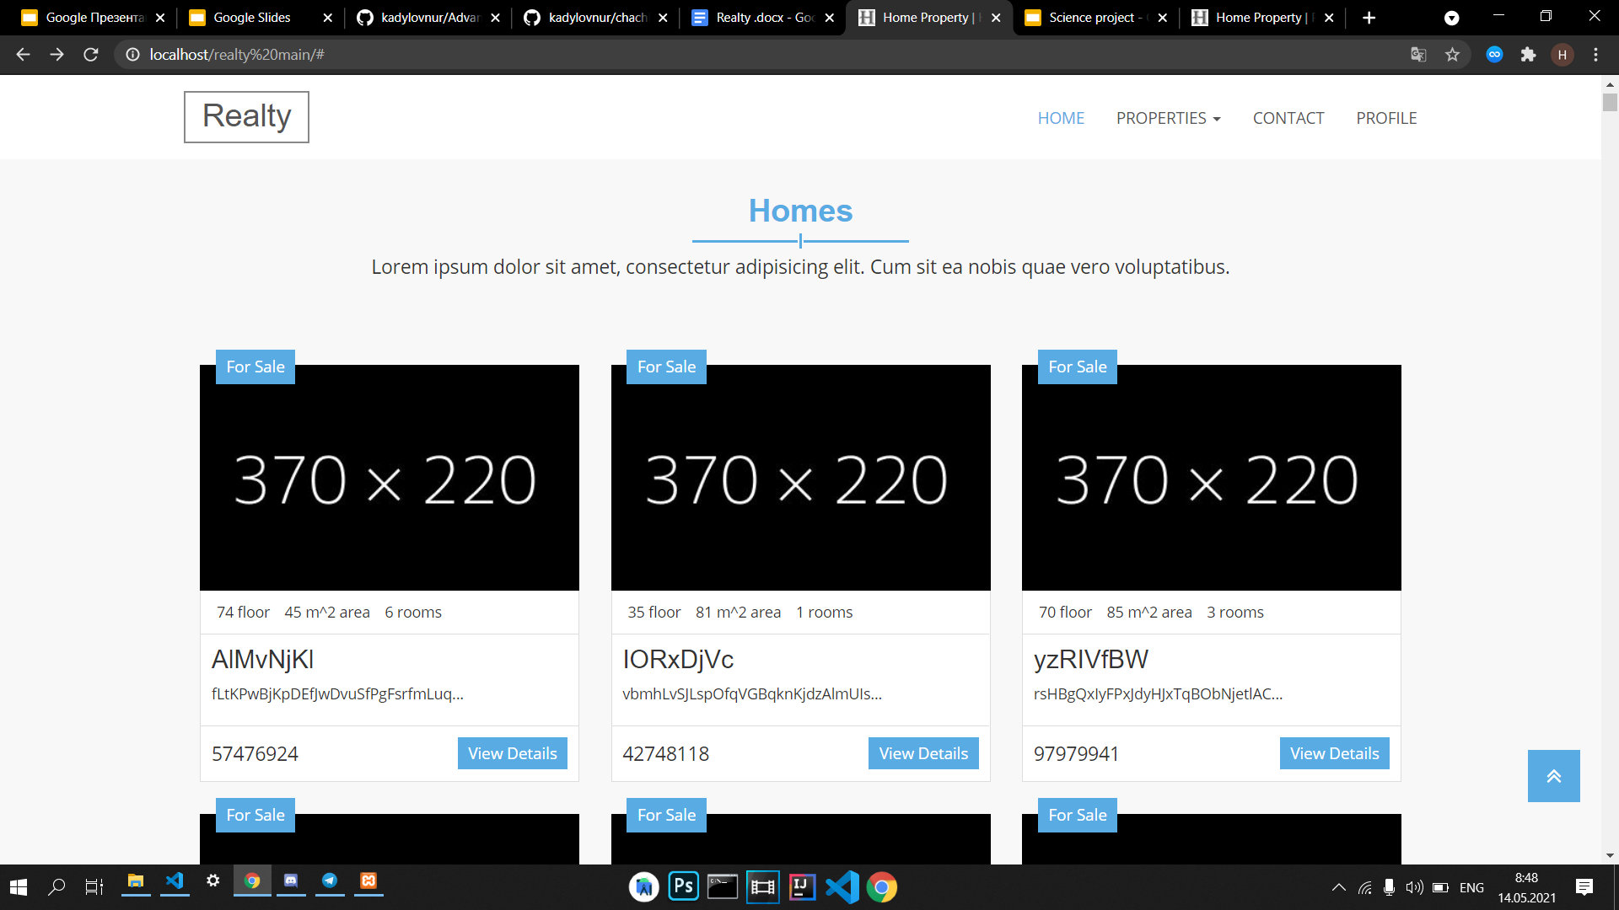

Slide 8
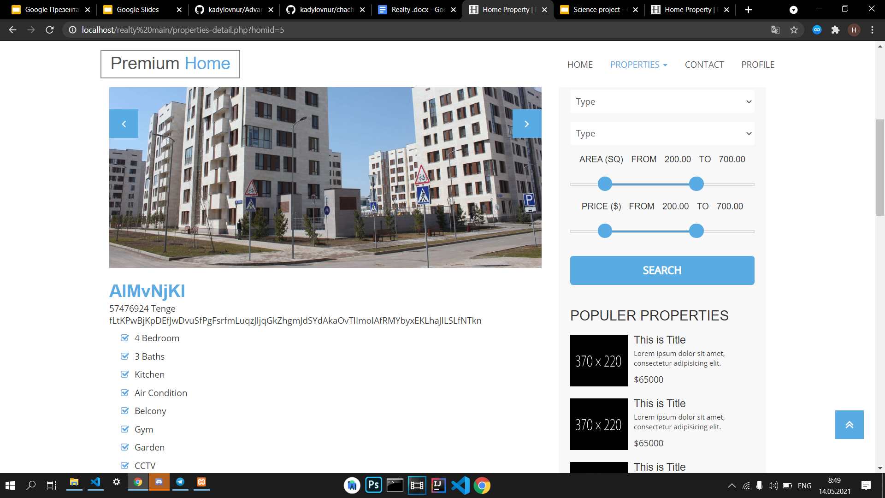

Slide 9
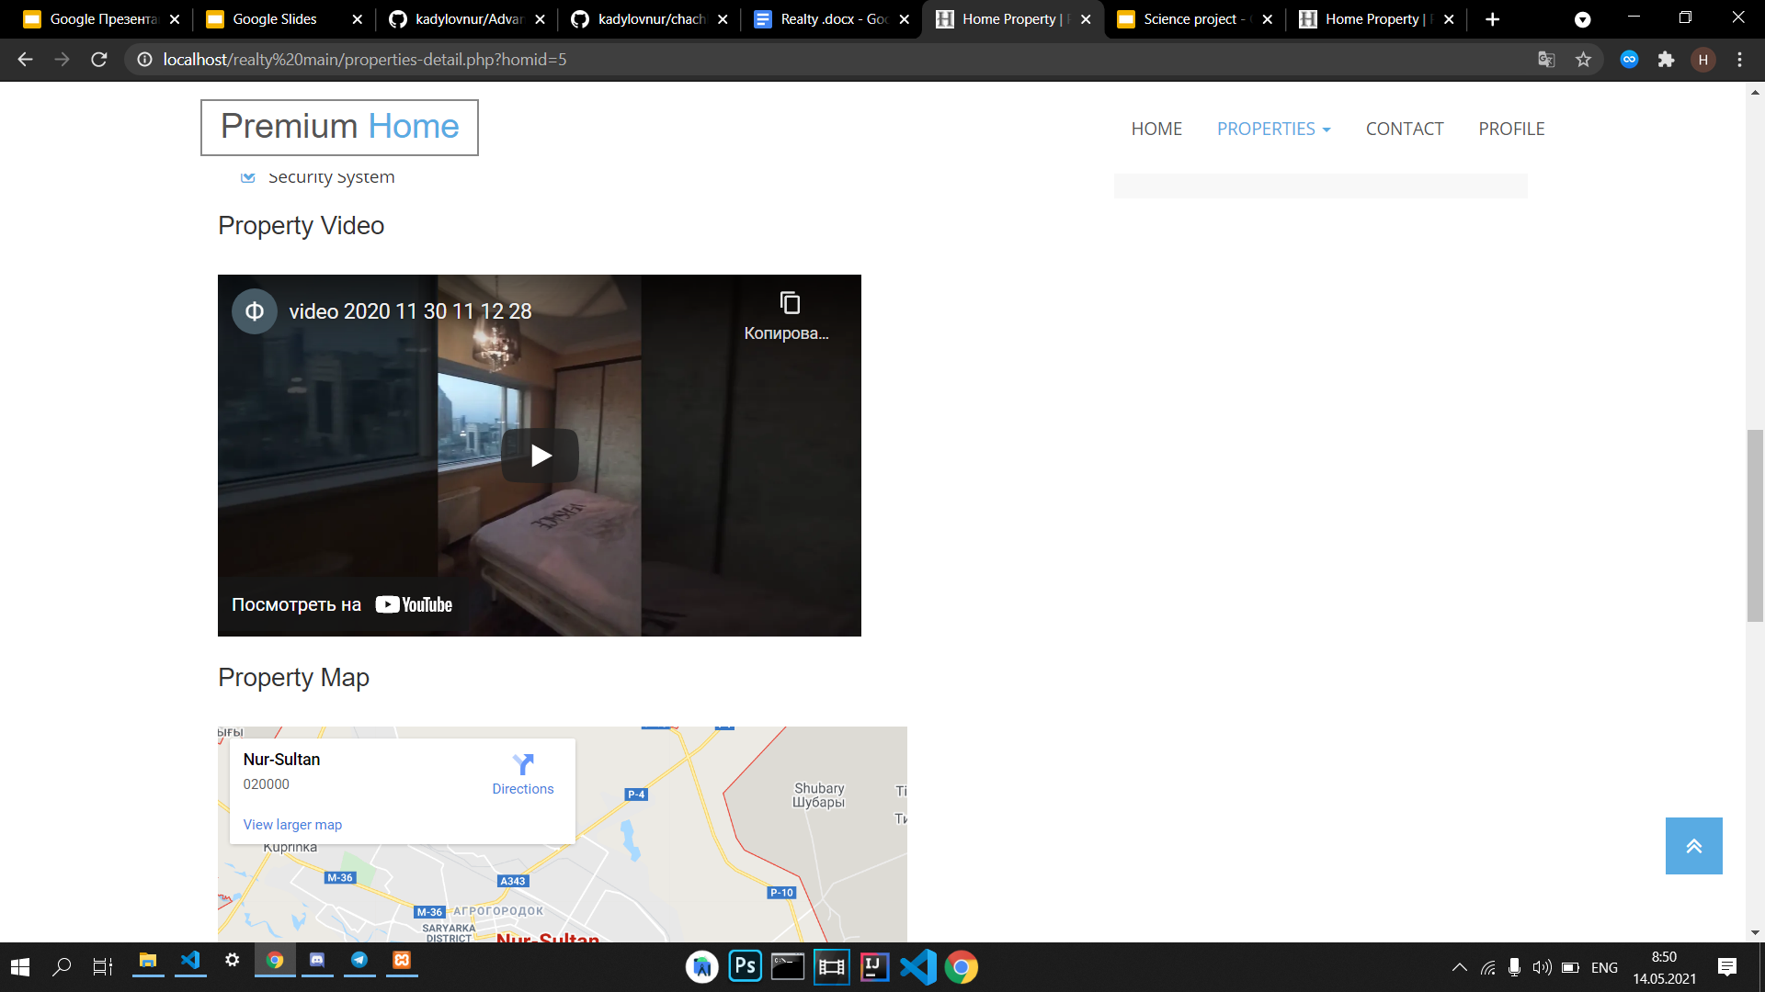

Slide 10
Let’s see it!

